Slide 1
Installing & Deploying the 3DEXPERIENCE Platform
3DEXPERIENCE 2014X

Slide 2
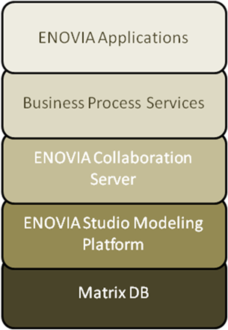
ENOVIA Layers
Business
Modeling Schema Elements
Matrix
MQL
Managing storage areas
Object Browser
Object Browser
System
Notes:
Business Modeler -The Business Modeler application is used to model the types of objects used in your business, along with the attributes, process rules, and persons associated with those objects. Your business model defines how you will use eMatrix, and can be changed as often as your business needs change.
eMatrix Navigator- The eMatrix Navigator application is used to create specific instances of the objects that were defined in the Business Modeler.
Matrix Query Language(MQL) -The MQL application uses a command driven interface to all of the above components. The MQL language helps the Business or System Administrator set up and test an eMatrix database quickly and efficiently. The MQL language can be used within the Business Modeler to create custom programs that allow you to tailor eMatrix to your specific business needs.
System Manager-The System Manager application is used to perform activities related to the configuration and maintenance of database storage locations.

Slide 3
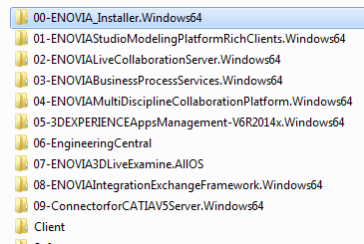
The Installables

Slide 4
Modeling Studio
Business
Modeling Schema Elements
Matrix
Object Browser
MQL
Scripting interface
System
Managing storage areas
Notes:
Business Modeler -The Business Modeler application is used to model the types of objects used in your business, along with the attributes, process rules, and persons associated with those objects. Your business model defines how you will use eMatrix, and can be changed as often as your business needs change.
eMatrix Navigator- The eMatrix Navigator application is used to create specific instances of the objects that were defined in the Business Modeler.
Matrix Query Language(MQL) -The MQL application uses a command driven interface to all of the above components. The MQL language helps the Business or System Administrator set up and test an eMatrix database quickly and efficiently. The MQL language can be used within the Business Modeler to create custom programs that allow you to tailor eMatrix to your specific business needs.
System Manager-The System Manager application is used to perform activities related to the configuration and maintenance of database storage locations.

Slide 5
Modeling Studio
Business
Matrix
MQL
Oracle
System
DB
Bootstrap File

Slide 6
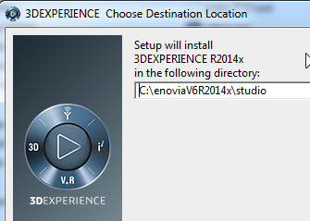
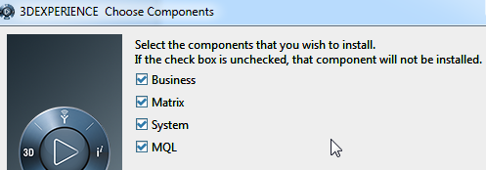
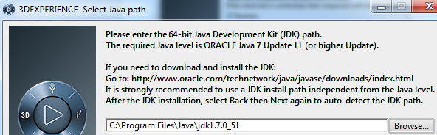
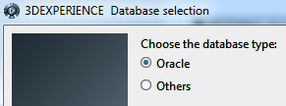
Studio Modeling Platform Client

Slide 7
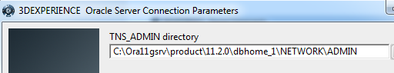
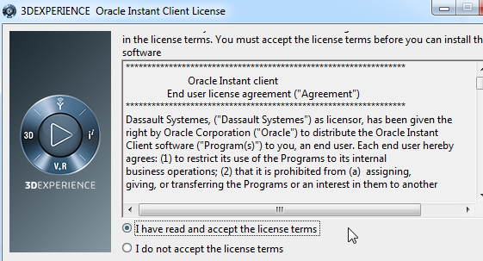
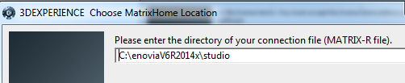
Studio Modeling Platform Client

Slide 8
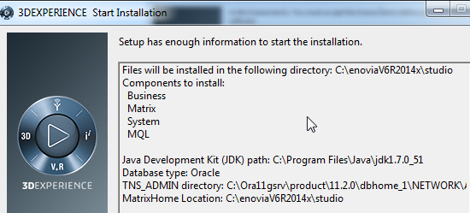
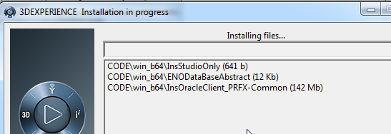
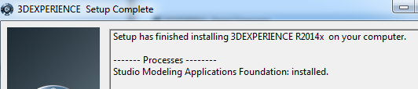
Studio Modeling Platform Client

Slide 9
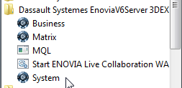
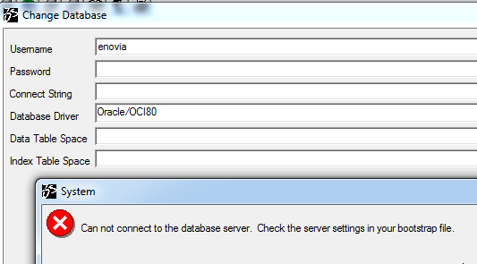
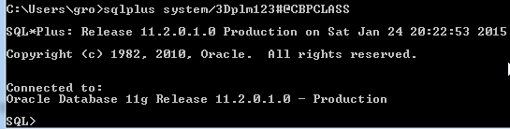
Connecting ENOVIA to DB using MATRIX_R
Launch System
System cannot find the database
How would ENOVIA know which db service to connect to?
How do you connect to Oracle backend? sqlplus system/3Dplm123#@CBPCLASS
Oracle connection credentials to ENOVIA

Slide 10
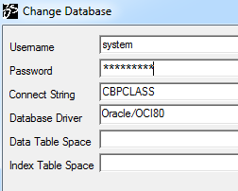
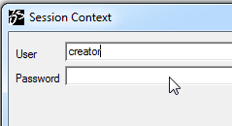
Create Oracle user dedicated for ENOVIA to connect
I try with system/3Dplm123#@CBPCLASS
Provide session context as creator The connection succeeds
But we will not use system
DS recommends a specific way of creating the Oracle user for ENOVIA connection
We follow that way in the next step

Slide 11
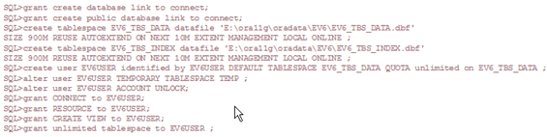
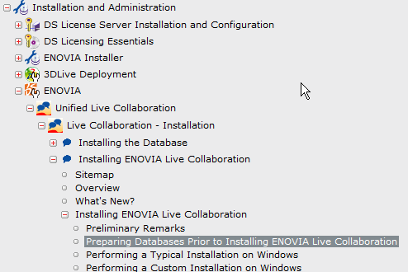
Oracle User for ENOVIA as recommended in DSDOC
Two Tablespaces were created
EV6_TBS_DATA for data
EV6_TBS_INDEX for index
User Name is EV6USER

Slide 12
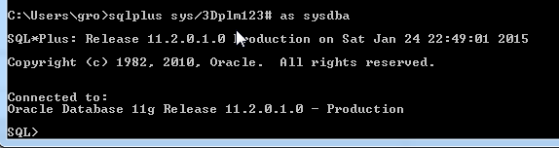
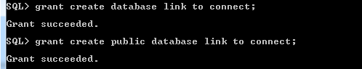
Oracle User for ENOVIA

Slide 13
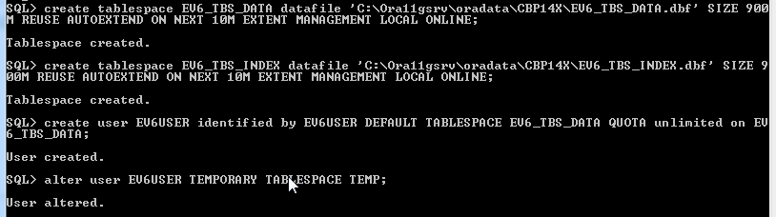
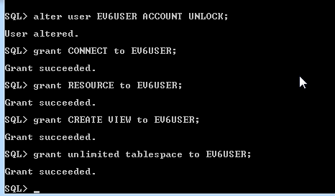
Oracle User for ENOVIA

Slide 14
Oracle User for ENOVIA
SQL> grant create database link to connect;
Grant succeeded.
SQL> grant create public database link to connect;
Grant succeeded.
SQL> create tablespace EV6_TBS_DATA datafile 'C:\Ora11gsrv\oradata\CBP14X\EV6_TBS_DATA.dbf' SIZE 900 M REUSE AUTOEXTEND ON NEXT 10M EXTENT MANAGEMENT LOCAL ONLINE;
Tablespace created.
SQL> create tablespace EV6_TBS_INDEX datafile ‘C:\Ora11gsrv\oradata\CBP14X\EV6_TBS_INDEX.dbf' SIZE 900M REUSE AUTOEXTEND ON NEXT 10M EXTENT MANAGEMENT LOCAL ONLINE;
Tablespace created.
SQL> create user EV6USER identified by EV6USER DEFAULT TABLESPACE EV6_TBS_DATA QUOTA unlimited on EV6_TBS_DATA;
User created.
Replace by your Oracle installation path

Slide 15
Oracle User for ENOVIA
SQL> alter user EV6USER TEMPORARY TABLESPACE TEMP;
User altered.
SQL> alter user EV6USER ACCOUNT UNLOCK;
User altered.
SQL> grant CONNECT to EV6USER;
Grant succeeded.
SQL> grant RESOURCE to EV6USER;
Grant succeeded.
SQL> grant CREATE VIEW to EV6USER;
Grant succeeded.
SQL> grant unlimited tablespace to EV6USER;
Grant succeeded.

Slide 16
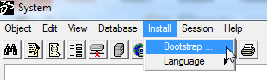
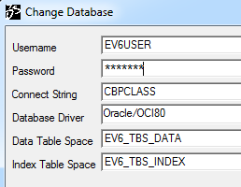
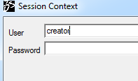
Connect ENOVIA to Database using the ENOVIA Oracle User
Install > Bootstrap
Provide the credentials The MATRIX_R file gets updated
Subsequently the context user has to be provided (creator) creator does not get listed for EV6USER To investigate
Alternatively, create user as specified in the next step
Notes:
Key question here is where is creator user in the db? Which tablespace does it reside in? Even before MATRIX_R file is generated, creator already exists. So its installed by the Studio Modeling
Client installation. How is creator user different from the EV6USER we create here? Is creator an oracle user? Of course it should be Details awaited for updating this document

Slide 17
Alternative steps of creating ENOVIA ORACLE User
create user cbp identified by enoviadb;
grant dba to cbp;
grant connect to enoviadb;
grant EXP_FULL_DATABASE to enoviadb;
grant IMP_FULL_DATABASE to enoviadb;
grant resource to enoviadb;
grant unlimited tablespace to enoviadb;
grant all privileges to enoviadb with admin option;
commit;

Slide 18
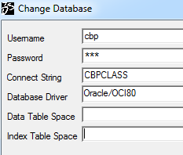
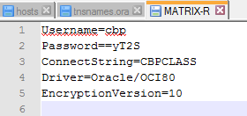
Connect ENOVIA to Database using the ENOVIA Oracle User
Install > Bootstrap
Provide the credentials The MATRIX_R file gets updated
Subsequently the context user has to be provided (creator)
Logs in to System succeeds
The MATRIX_R file is updated as seen below with the new credentials The password is encrypted
Notes:
Key question here is where is creator user in the db? Which tablespace does it reside in? Even before MATRIX_R file is generated, creator already exists. So its installed by the Studio Modeling
Client installation. How is creator user different from the EV6USER we create here? Is creator an oracle user? Of course it should be Details awaited for updating this document

Slide 19
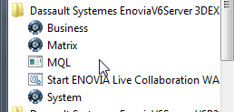
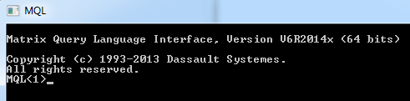
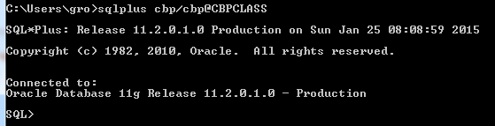
Confirm connection by logging in to MQL & SQL prompt
Log in to MQL
The MQL prompt must appear
It confirms ENOVIA could succeeds to connect to the database
Additional we also confirm connection to the SQL prompt with these credentials

Slide 20
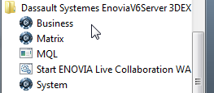
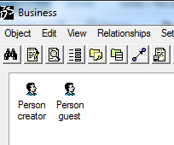
Any change in schema?
Log in to Business
You will still notice 2 users have been created in the db
creator
guest

Slide 21
Studio Modelling Client is installed …

Slide 22
Going Ahead ….
The installations that happen after this are the following:
Live Collaboration Server
Business Process Services
MultiDiscipline Collaboration Platform (VPM)
Apps Management
Engineering Central
3D Live Examine
Integration Exchange Framework
Connector for CATIA V5 Server
Each of these install their own schemas. This requires access to the Oracle database with appropriate credentials
In the earlier step we confirmed connection to the Oracle db & the credentials are now updated & read from MATRIX_R file

Slide 23
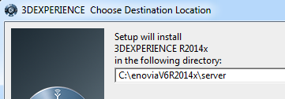
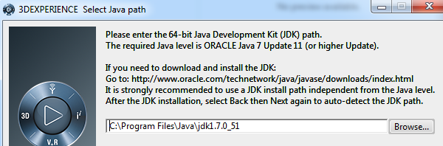
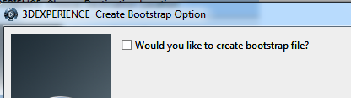
Live Collaboration Server Installation

Slide 24
ENOVIA Layers
Business
Modeling Schema Elements
Matrix
MQL
Managing storage areas
Object Browser
Object Browser
System
Bootstrap File
DB
Notes:
Business Modeler -The Business Modeler application is used to model the types of objects used in your business, along with the attributes, process rules, and persons associated with those objects. Your business model defines how you will use eMatrix, and can be changed as often as your business needs change.
eMatrix Navigator- The eMatrix Navigator application is used to create specific instances of the objects that were defined in the Business Modeler.
Matrix Query Language(MQL) -The MQL application uses a command driven interface to all of the above components. The MQL language helps the Business or System Administrator set up and test an eMatrix database quickly and efficiently. The MQL language can be used within the Business Modeler to create custom programs that allow you to tailor eMatrix to your specific business needs.
System Manager-The System Manager application is used to perform activities related to the configuration and maintenance of database storage locations.

Slide 25
ENOVIA Layers
ENOVIA Studio Modeling Platform
Business
Modeling Schema Elements
Matrix
MQL
Managing storage areas
Object Browser
Object Browser
System
Bootstrap File
DB
Notes:
Business Modeler -The Business Modeler application is used to model the types of objects used in your business, along with the attributes, process rules, and persons associated with those objects. Your business model defines how you will use eMatrix, and can be changed as often as your business needs change.
eMatrix Navigator- The eMatrix Navigator application is used to create specific instances of the objects that were defined in the Business Modeler.
Matrix Query Language(MQL) -The MQL application uses a command driven interface to all of the above components. The MQL language helps the Business or System Administrator set up and test an eMatrix database quickly and efficiently. The MQL language can be used within the Business Modeler to create custom programs that allow you to tailor eMatrix to your specific business needs.
System Manager-The System Manager application is used to perform activities related to the configuration and maintenance of database storage locations.

Slide 26
Who installs the MATRIX_R (bootstrap) file?
The MATRIX_R file could be generated using System (Studio Modelling Client installed) or at the time of installing the Live Collaboration Server
Please note that Studio Modeling Client installation is optional for end users, since only those who would want to customize ENOVIA will install it
As a result the option to generate MATRIX_R file is provided at the time of Live Collaboration Server installation because it is this lowest component in the ENOVIA architecture which actually talks to the Oracle database

Slide 27
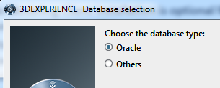
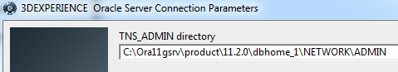
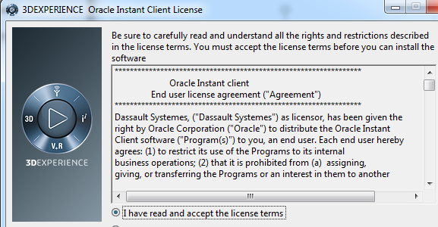
Live Collaboration Server Installation

Slide 28
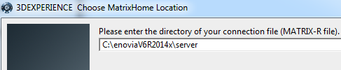
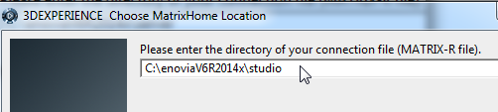
MATRIX_R at the studio location
Please note the path It displays the server path
Our MATRIX_R file was created in the studio path
We will rely on a single MATRIX_R file which will be commonly referred to by System and Live Collab Server
Hence we change this path to that of studio

Slide 29
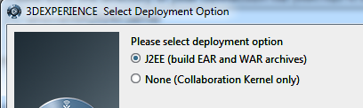
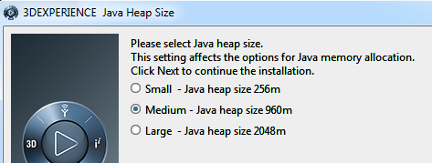
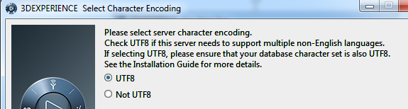
Installation in progress …

Slide 30
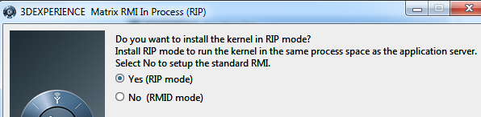
RIP Mode Installation
More on this later …
But remember we selected the RIP mode here

Slide 31
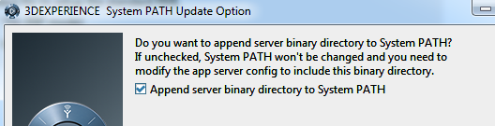
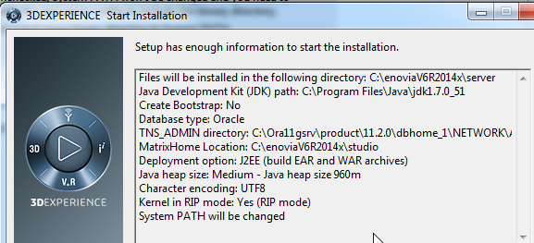
ENOVIA install folder updated in System PATH
Every new installation of ENOVIA will append the System PATH with the server binary directory
Hence its recommended to have a single ENOVIA installation on your machine or ensure that the ENOVIA install you want to refer to, occurs first in the PATH

Slide 32
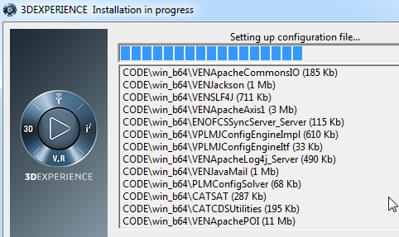
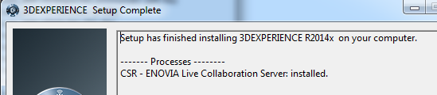
Installation in Progress …

Slide 33
Any change in schema?
Log in to Business
You will still notice only 2 users exist in the db so far
creator
guest

Slide 34
Live Collaboration Server is installed …

Slide 35
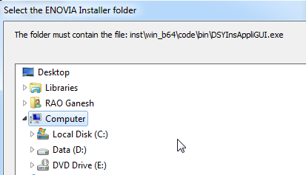



Business Process Service Installation

Slide 36



Business Process Service Installation

Slide 37



Business Process Service Installation

Slide 38



Business Process Service Installation

Slide 39


A lot of tcl’s are being executed …

Slide 40

What happens to the Schema?
Quite a lot of schema gets installed

Slide 41
Business Process Service is installed …

Slide 42


MuliDisciple Collaboration Platform Installation

Slide 43


MuliDisciple Collaboration Platform Installation

Slide 44

MuliDisciple Collaboration Platform Installation
Watch out for this
It is specific to the VPM installation wherein you can provide the Administrator name of your choice

Slide 45


MuliDisciple Collaboration Platform Installation

Slide 46



MuliDisciple Collaboration Platform Installation

Slide 47

What happens to the Schema?
VPM specific schema is now installed

Slide 48
Multidiscipline Collaboration Platform is installed …

Slide 49


Apps Management Installation
The Installer path is input

Slide 50



Apps Management Installation
Server path and admin credentials to write to the database

Slide 51



Apps Management Installation
Installation begins

Slide 52
ENOVIA Apps Management is installed …

Slide 53
Engineering Central Installation
Select the ENOVIA Installer path

Slide 54

Engineering Central Installation
Choose the server installation path
Also the superuser (creator) credentials are input to write schema into the Oracle db

Slide 55


Engineering Central Installation
Custom schema installation path is displayed and the installation begins

Slide 56


Engineering Central Installation
TCLs are getting executed & the installation is complete

Slide 57

What happens to the Schema?
Engineering Central Schema gets finally installed

Slide 58
ENOVIA Engineering Central is installed …

Slide 59
Deploying the ENOVIA Application inside TOMCAT

Slide 60


Generating the WAR (Web Archive file)
Find the war_setup.bat file in the ENOVIA Install folder\server\win_b64\code\command
Run the war_setup.bat file

Slide 61


The distrib folder thus gets generated
It has the ear and war files in it
The war file is that which is of interest to us

Slide 62


Deploying the war file in TOMCAT
Copy the war file from the distrib folder to your TOMCEE folder
Go to the command prompt
Change directory to the TOMEE bin directory
Set the JAVA_HOME & CATALINA_HOME variables in the console
Run startup.bat

Slide 63

Deploying the war file in TOMCAT
This is what the Tomcat console outputs typically on successfully deploying ENOVIA
Confirm in your PATH settings you have the path of the current ENOVIA install ONLY

Slide 64

Confirm the Apache Home Page is launched
http://localhost:8080

Slide 65

Confirm next log in to ENOVIA with Test Everything user
http://localhost:8080/enovia
Failure because Test Everything does not have the basic licenses

Slide 66

Confirm next log in to ENOVIA with Test Everything user
Open MQL prompt
Assign licenses IFW, CNV, CSV, & BOM to “Test Everything”

Slide 67

Test Everything logged in and ENBOM accessible
ENOVIA is finally hosted and launched from your web browser
What follows will be the Customization of ENOVIA …

Slide 68




Backup your DB for the CBP Start Up environment

Slide 69
ENOVIA Installed & Deployed

